Slide 1
Entity Framework Dot Net Core

Slide 2
Scaffold
Scaffold-DbContext "Server=(local);user=nook;password=1234;Database=NORTHWND;Trusted_Connection=True;" Microsoft.EntityFrameworkCore.SqlServer -OutputDir Models –Tables Customers,Orders,"Order Details",Products

Slide 3
Link
https://docs.microsoft.com/en-us/ef/core/get-started/aspnetcore/existing-db

Slide 4
LINQ
Lamda
(params) => {statements}
Query
from cust in db.customers where cust.City == "London" select cust;

Slide 5
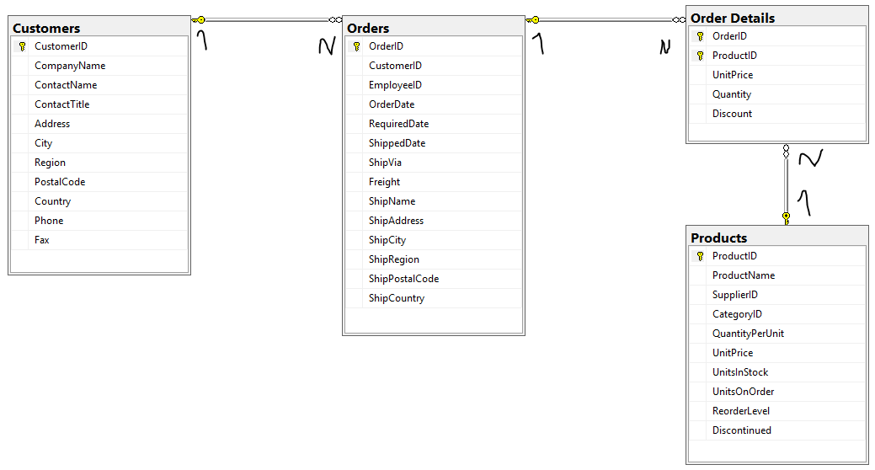
Northwind database
From https://northwinddatabase.codeplex.com/

Slide 6
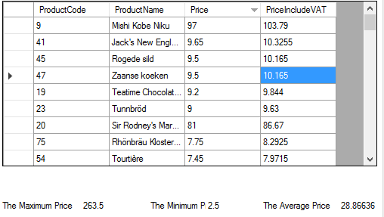
Assignment
Using NORTWIND Database to query.
In this assignment query from Product table.
1.) What SQL ?
What SQL ?
2) Max Price
3) Min Price
4) Average Price

Slide 7
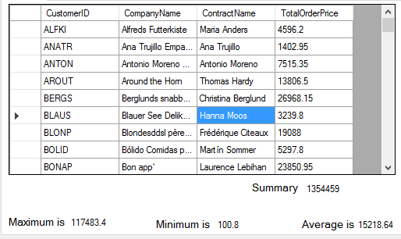
Advance Assignment
Using NORTWIND Database to query.
In this assignment query from Product table and relate table.
1.) What SQL ?
(TotalOrderPrice = Quantity * UnitPrice)
What SQL ?
2) Max TotalOrderPrice
3) Min TotalOrderPrice
4) Average TotalOrderPrice
5) Sum TotalOrderPrice

Slide 8
Thanks!
Any questions?
You can find me at @username & user@mail.me

